Slide 1
Introduction to Project STRONG: Serving Newcomer Students in the Downstate Region
May 14, 2024

Slide 2
Funder Acknowledgement
This 2-year program to train & coach school-based health centers in delivery of a therapeutic group modality, STRONG, to support newcomer students would not be possible without funding from the New York Community Trust. The New York School-Based Health Foundation is deeply grateful to NYCT for this grant.

Slide 3
AGENDA
Speaker Introductions
What is STRONG?
Program Components
Next Steps
Video on STRONG (as time allows)
Questions

Slide 4
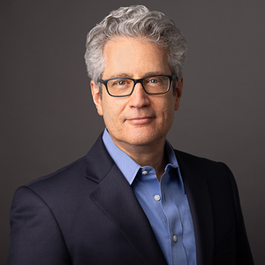
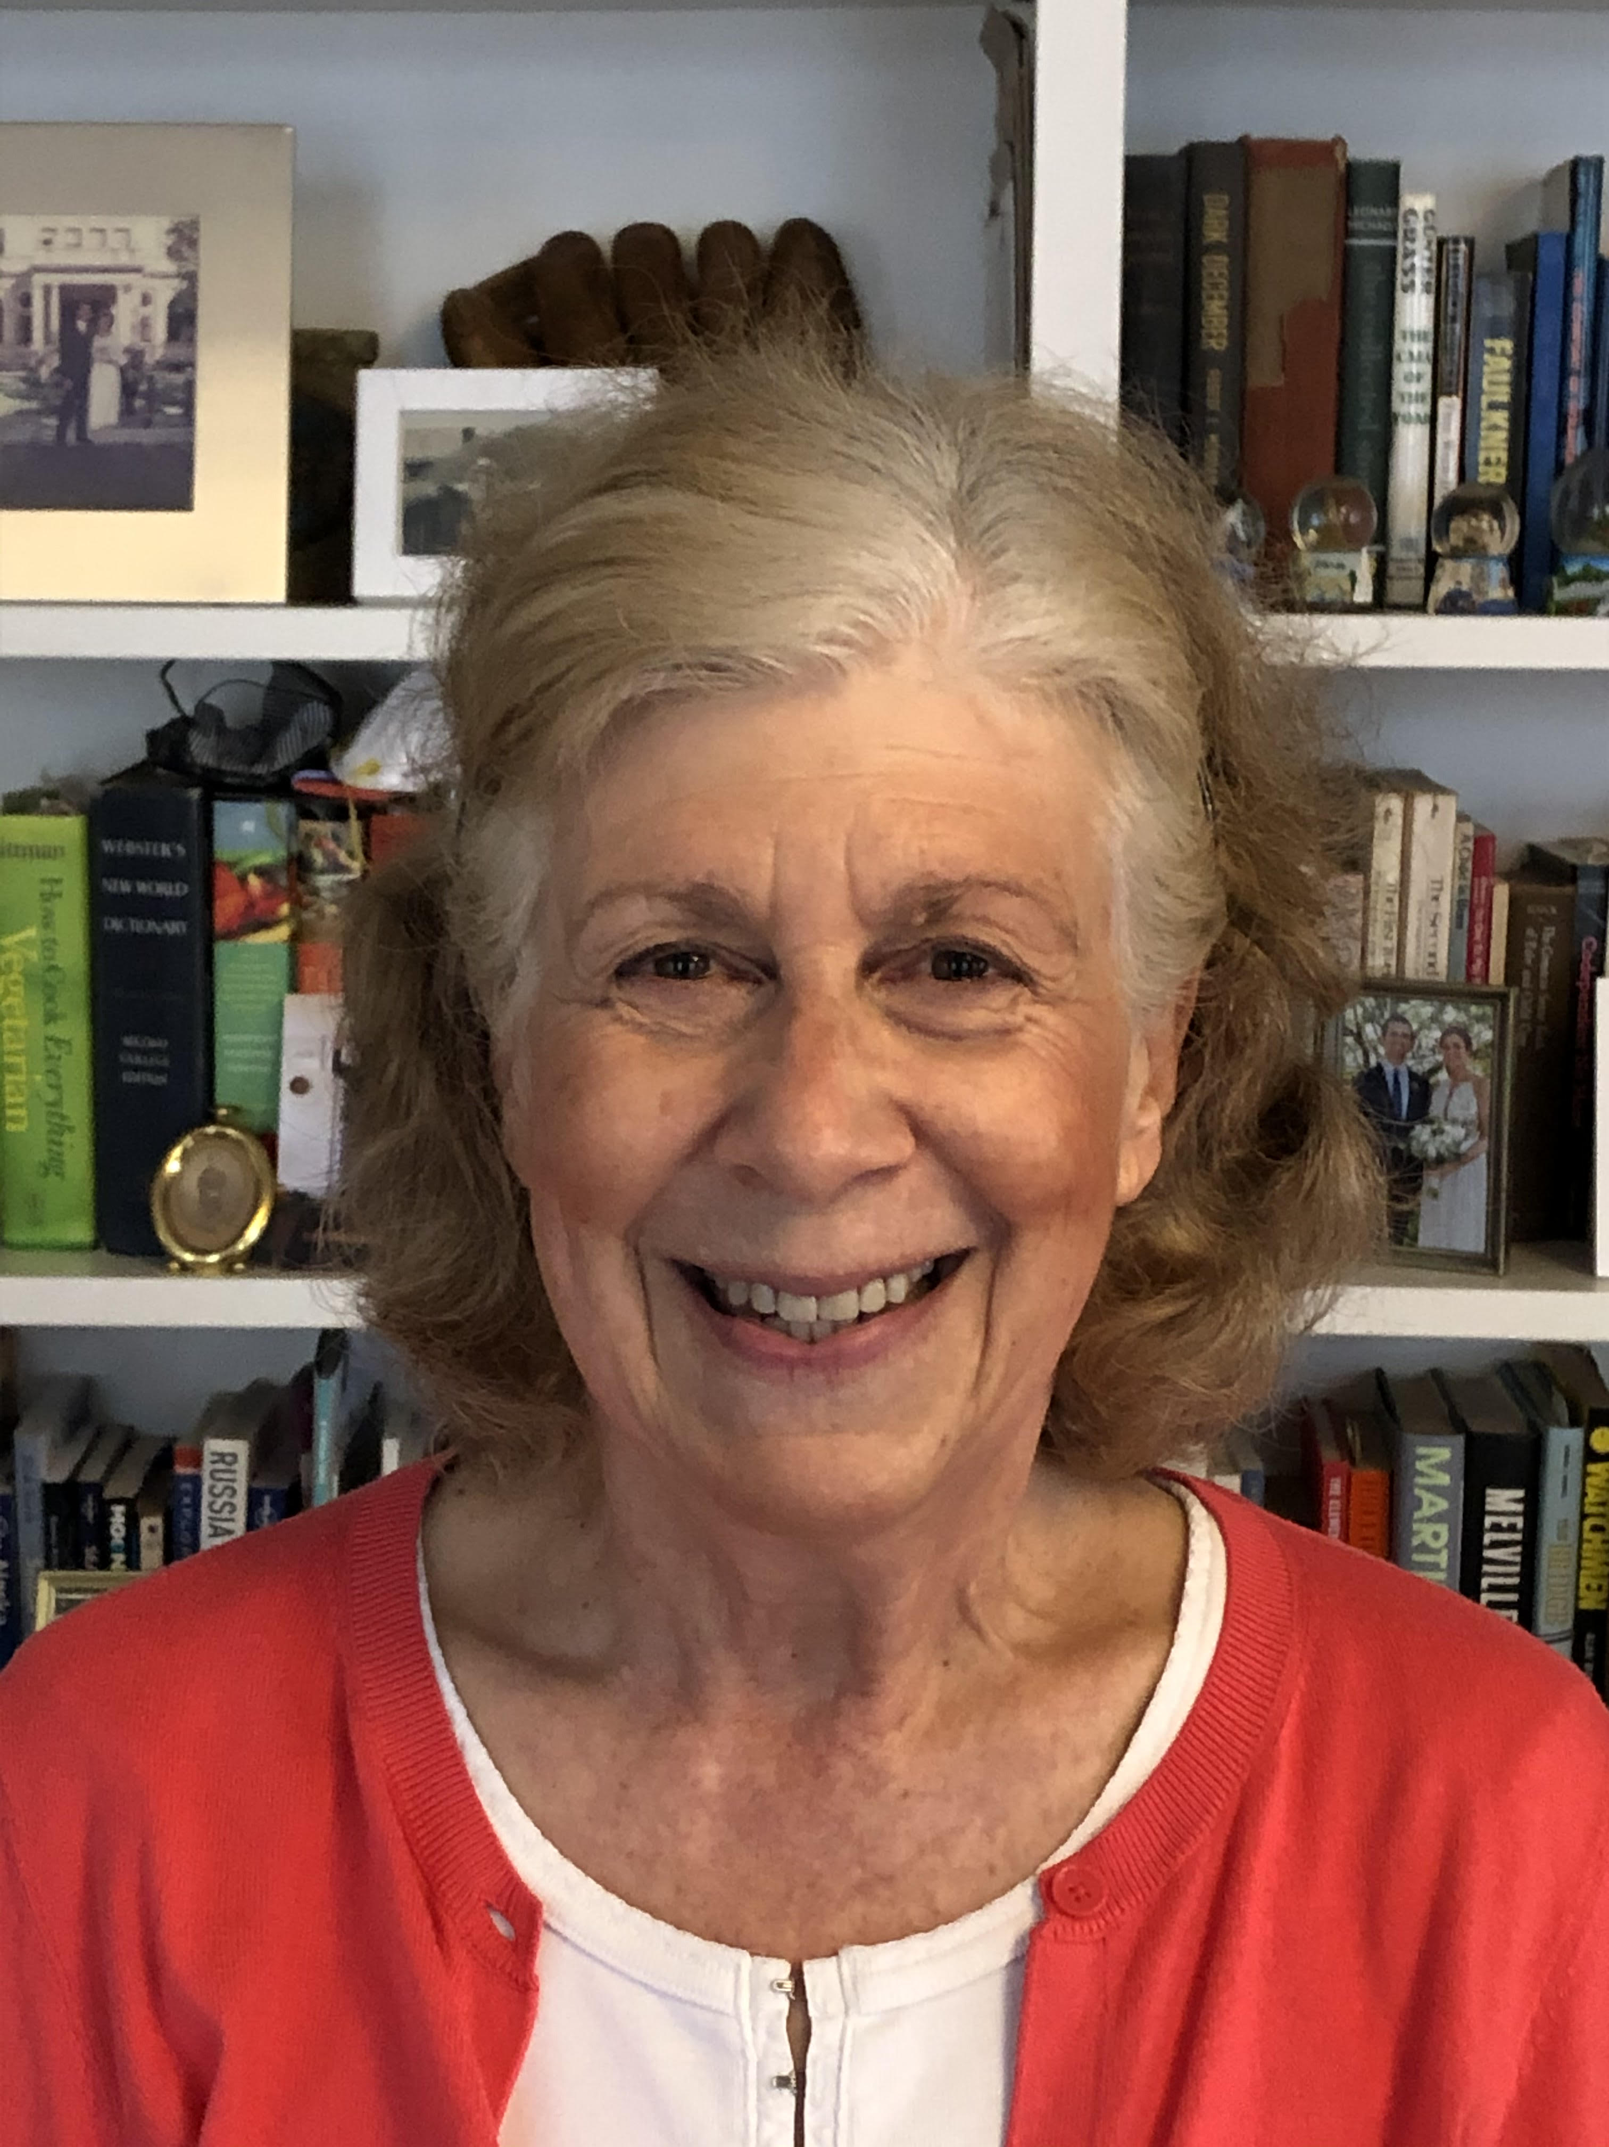
Today’s Speakers
Scott Bloom
Lisa Perry
34 years in the mental health field working with children and families.
Created opportunities for children and youth to overcome emotional and behavioral barriers to academic achievement, multiple community agencies.
Founding Director of School Mental Health Services for the New York City Department of Education for the last 15 years
Serves on advisory boards for cities, state, and national mental health initiatives around the country.
Principal at Morningside Health Strategies since 2019, with engagements focused on technology- and data-enabled innovation in patient care and operations, performance improvement & financial sustainability.
Previously served as Sr. Vice President, Quality & Technology at the Community Health Care Association of New York State (CHCANYS).
Currently directing the NYSBH Foundation and its grant-funded programs.
Board Officer and Chair, Quality Improvement Committee, at Ryan Chelsea-Clinton, a NYC FQHC.

Slide 5
What is STRONG?
Supporting Transition Resilience of Newcomer Groups
A structured, evidence-based program of group therapy designed to support newcomer students. 10 groups sessions, 1 individual student session, teacher & parent education sessions.
STRONG was developed by experts in education, trauma, mental health & newcomer populations at universities in the US & Canada. It was initially created to address distress & trauma of Syrian migrant children arriving in Canada in 2015.

Slide 6
STRONG: Goals & Curriculum
Goals
Building resilience & promoting health adjustment
Increasing social support & connections
Increasing positive sense of identify, buffering racism & xenophobia
Developing strategies to cope with stress & trauma
Building problem-solving & goal-setting skills
Curriculum
Manual & materials, free access
Resilience-building skills
Understanding & normalizing distress
Cognitive Behavioral Intervention Skills: relaxation, cognitive coping, exposure, goal setting, problem solving
Journey narrative
Peer, Parent & Educator Support

Slide 7
Sessions 1-5
Session 1: My Inside Strengths and Outside Supports
Session 2: Understanding Stress
Session 3: Common Stress Reactions and Identifying Feelings
Session 4: Measuring and Managing Feelings
Session 5: Using Helpful Thoughts

Slide 8
Sessions 6-10, Individual, Parent/Teacher
Session 6: Steps to Success
Session 7: Problem-Solving
Session 8: My Journey – Part I
Session 9: My Journey – Part 2
Session 10: Graduation
Individual Session (Journey Preparation)
Individual Meeting with Parents/Caregivers
Parent Session
Teacher/Interpreter Session

Slide 9
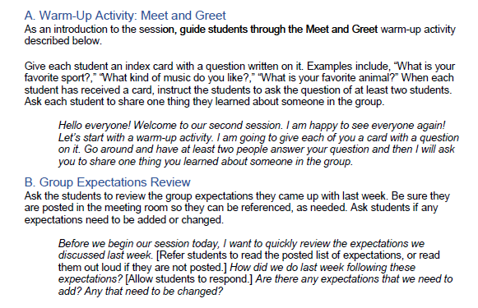
Session Components
Each session has section headers, explanation of activities, and guided scripts. Scripts are italicized and unspoken parts are in [block brackets].

Slide 10
NYSBHF Program Components:
10 SOs in the 8 downstate counties: NYC, Suffolk, Nassau & Westchester.
2-day intensive training in the STRONG therapeutic group modality for newcomer students, elementary or secondary.
Training provided by STRONG for Schools. September 17 & 24, 2024
10 hours of coaching per Sponsoring Organization (SO) by STRONG over the grant period.
Consultation on program implementation and grant deliverables with program Subject Matter Expert, Scott Bloom.
Use of STRONG in group treatment, to begin after training. Each participating SBHC site must successfully complete 3 groups, including pre- and –post treatment clinical assessments, over the 2-year program period.
Parent & teacher education presentation.
Reporting on quantifiable outcomes including:
Pre- and post-treatment assessments, using the same tool across all participating sites.
1-2 Peer Sharing Sessions

Slide 11
Next Steps
Complete application by May 31. Notification by June 14.
a. Application link here: https://forms.gle/t4SPxaZMFxkw5Rom7
Once accepted into the program:
Memorandum of Understanding (MOU)
Workplan
Over the Summer
Brief kickoff with participating organizations
Plan for student recruitment
Address logistics: space, schedule, etc.
Training: September 17 & 24, 2024
Launch of first groups: October 2024

Slide 12
Questions
Scott Bloom, Subject Matter Expert
sbloomlcsw@gmail.com
Lisa Perry, Program Director
lisa.perry@nysbhfoundation.org
For more information on STRONG:
Home | STRONG for Schools

Slide 13
STRONG Video

