Slide 1
School-Based Behavioral Healthcare in a Mid-Pandemic World:
A Program to Strengthen Capacity to Meet the Needs of Students & Families
NY STATE HEALTH FOUNDATION PRESENTATION
MAY 23, 2022
Notes:
Ronda
Welcome

Slide 2
Funder Acknowledgement
This 2-year program to strengthen the capacity of school-based health centers to deliver behavioral health care to the students of New York State would not be possible without the support of the New York Community Trust and the New York State Health Foundation. The New York School-Based Health Foundation is deeply grateful to these two funders for their understanding of the importance of this work, their vision and their trust in us.
Notes:
Lisa
READ SLIDE

Slide 3
Program Overview
A 2-year program funded by the New York Community Trust and The New York State Health Foundation, serving 10 Sponsoring Organizations (SOs) each year
Grant year runs for entire calendar year, e.g., January – December 2022
Goal: to enhance the capacity of the New York State’s School-Based Health Centers (SBHCs) to respond to the increase in students’ behavioral health needs resulting from the COVID-19 pandemic.
Notes:
Lisa –
READ SLIDE

Slide 4
What is a School-Based Health Center?
A health care provider site located within a school in an underserved, low-income neighborhood
SBHCs provide care to the school’s students and in some cases, members of the surrounding community
SBHCs provide Medical, Behavioral Health & Dental care and are frequently students’ only source of health care
SBHCs are operated by hospitals, federally qualified health centers and other licensed health care organizations, known as Sponsoring Organizations
Throughout New York State, 47 SOs operate 266 SBHC sites serving 250,000 students in urban and rural areas
Notes:
Lisa –
READ SLIDE
Our cohort of 10 Sponsoring Organizations operate 70 sites throughout the State.
43% of these sties are upstate in Buffalo, Rochester and the Cooperstown area.
The remaining sites are in the 5 counties of New York City.
Additional info on Statewide network, if asked:
~168/264 = 64% or roughly two-thirds of all sites are in NYC, one-third in rest-of-state
There are only a few SOs operating in rural areas, and we are hearing that staff recruitment is extremely difficult in these areas.
Re: provision of BH services on site:
All 16 SOs (roughly 1/3 of all SOs) who responded to our survey offer BH services on-site. We do not yet have data on all SOs.
The State does not publish this data, but we hope to be able to share it through our data hub as we continue to add SOs and their data to this program of the NYSBHF.
SBHCs are underfunded and under-resourced in general. In many cases, lead administrators are also clinicians, with significant patient care duties, making it difficult to also lead improvement initiatives.
There is no mechanism through Medicaid for most SBHCs to bill for group or universal interventions which are so critical to BH.
We have submitted comments to bring attention to the need for full inclusion of SBHCs in the pending New York State Medicaid Waiver application.

Slide 5
Program Components
10 hours of customized, individual technical assistance for each SO from our Subject Matter Expert (SME) to address your priority issues
3 educational webinars on topics of shared interest, to include best practices and peer sharing
Web-based Resource Library
Start-up stipend for an improvement project designed by each SO in consultation with program
Reporting on quantifiable outcomes
Session at NYSBHA annual conference
Notes:
Lisa
START HERE Modeled after our successful Telehealth Program, Year 1
READ SLIDE
This is a capacity-building grant and SOs have chosen a variety of projects to enhance capacity, including:
pilots of curricula and early intervention groups for students;
clinical staff training in evidence-based therapeutic methods (e.g. DBT);
Universal, school-wide events to promote mental health awareness and available services.

Slide 6
Why Mental Health at SBHCs?
Schools Are On the Frontlines of Communities
Increases resilience and help-seeking behavior
Improvement in…
Student decision-making
School culture and commitment to school
Student social emotional skills
Positive interactions with others
Increased knowledge about mental health
Decreased mental health stigma
Fewer…
Referrals based on challenging behavior
Referrals for special education services
Students in restrictive environments
Decreased disruption from class time and school activities
Improved academic achievement
Increased teacher confidence around mental health
Mental Health Affects Student Achievement
Notes:
This section is for longer presentations (over 20 minutes). It is appropriate for any audience.
There are many positive outcomes by having mental health services on-site in the schools. I’m sure you are all familiar with them. I wanted to highlight treatment modality: parents don’t have to miss work taking their children to an out pt. community clinic and kids don’t miss school. Services on Premises – Like Dinners – Baked on Premises.
studies indicate that those in counseling or treatment do better in improving their grades and academic achievement (minimizes barriers to learning).
Both Parents and Teachers gain greater insight to mental health issues and therefore Parents can gain more confidence and parent more competently; teachers can manage their classrooms more effectively. I look for the SECONDARY GAIN – not only are kids getting the services and treatment that they need, stronger ties for families and schools, WIN-WIN
Talking points:
Logical point of entry to addressing student wellbeing.
Frontline identification of at-risk or presenting behavioral health concerns. Teachers and other school staff are with students for huge portions of the day.
Natural settings for students to learn social emotional skills.
For various reasons, students as well as caregivers/parents cannot follow up on appointments or ongoing treatment. Making services visible and/or available in schools will help to bridge this gap.
Increased access and follow-up for all, but closes the treatment and access gaps for students of color.
Schools are important influences for implementation of public health campaigns. Example – immunizations.
Most children needing mental health services do not receive them – BUT those that do, often receive services in school.
The sole provider for half of children with serious emotional disturbance.
Audience: Medium to long presentations. For any audience.
Talking points:
No
t all Health Clinics in schools have mental health services.

Slide 7
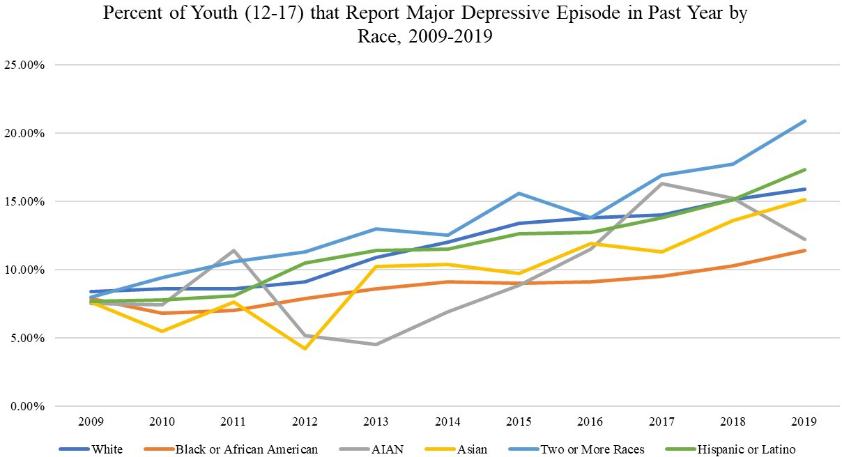
Youth Mental Health Trends are Troubling and Access to Care is Limited
Data Shows Significant Inequity in Outcomes and Access
The percent of youth experiencing depression has doubled in the past decade.
50% of mental health conditions begin before the age of 14 and 75% by age 24. The average delay is 11 years between symptoms and accessing care.
Suicide is the second-leading cause of death for youth, and the suicide death rate for Black youth is rising faster than any other racial/ethnic group.
Only roughly half of white youth and one-third of Black and Latino youth with major depression received treatment.
https://mhanational.org/addressing-youth-mental-health-crisis-urgent-need-more-education-services-and-supports
Notes:
https://mhanational.org/addressing-youth-mental-health-crisis-urgent-need-more-education-services-and-supports
NY State:
Youth with Major Severe Depressive Episodes in the Past Year – 8.3%
Youth with Major Depressive Episodes in the Past Year Who Did Not Receive Treatment 60.9%
By The Numbers
1,721,000
Number of K-12 Students (2022 Projection)i
179,000 Children with major depression
103,000 Children with major depression who do not receive treatment
1:648 Ratio of School Psychologists to Students
(Recommended Ratio 1:500)
1:773 Ratio of School Social Workers to Students
(Recommended Ratio 1:250)
1:288 Ratio of School Counselors to Students
(Recommended Ratio 1:250)

Slide 8
U.S. Department of Education Recommendations – since COVID
Prioritize wellness for each child, student, educator, and provider.
Enhance mental health literacy and reduce stigma and other barriers to access.
Implement a continuum of evidence-based prevention practices.
Establish an integrated framework of educational, social, emotional, and behavioral-health support for all.
Leverage policy and funding.
Enhance workforce capacity.
Use data for decision making to promote equitable implementation and outcomes.
Notes:
TAKE A PAUSE:​
​
The mental health crisis for children and youth in the United States has reached a critical point. The pandemic has exacerbated already alarming trends in mental health, and, without increasing the number of high-quality, evidence-based mental health services, the increased need for services for children and youth will not be met. ​
​
The current system is not working for many children, students, families, and staff, with notable problems that existed BEFORE the pandemic made much worse DURING the Pandemic. ​
​
This is exposing and highlighting our disparities that have already been devastating communities of color ​
This is likely to be a trauma reminder for students, staff, and families that have been experiencing racism and disparities their entire life​
​
Family Loss​
Increased Economic Stress​
Increased Family Stress​
Blended and Remote Learning
he COVID-19 pandemic has impacted the mental and emotional health and well-being of youth. In 2021, 15% of youth in the United States had a major depressive episode and 4% had a substance use disorder with the highest rate among youth of color, according to a Mental Health America report. Critically, Mental Health America also found that over half of LGBTQ+ youth screened for suicide risk experienced thoughts of suicide or self-harm. Despite increased need for youth behavioral health prevention and treatment, states are reporting decreased access and availability of services. Kaiser Family Foundation reported that outpatient mental health services declined by 58% for Medicaid and Children’s Health Insurance Program beneficiaries from January-May 2020. School-based behavioral health services have played a pivotal role in addressing the needs of students during the COVID-19 pandemic and beyond.
U.S. Department of Education came out this year with best practices on Supporting Child and Student Social, Emotional, Behavioral, and Mental Health Needs due to impact of COVID. While we don’t have much time to go into each of these right now, I wanted to highlight a few of them.
1. CHALLENGES include: inconsistencies in practices related to screening; referral; service provision for mental health or social, emotional, and behavioral challenges; and provider standards and competencies. Siloed delivery of care. SBHC are positioned to eradicate the siloing in schools.
2. Enhance Mental Health Literacy and Reduce Stigma and Other Barriers to Access
Given increased mental health needs associated with the pandemic and social challenges (e.g., racial injustice), there is an urgent need to improve access to mental health support by reducing barriers, changing attitudes and perceptions about mental health, and eliminating discriminatory practices that harm students with mental health challenges. We will go over some strategies later on. The goal is to eliminate stigma associated with seeking mental health support.
4. Much of our webinar today will speak to this recommendation. Do not create separate teams and systems for Mental Health in Schools. Schools won’t be able to do this effort alone. Families, child-serving partners, and community providers will be critical. It will be important to have a team focused on trends and patterns with focus on developing/ strengthening Mental Health promotion and prevention. Hold space to build trust and work toward establishing norms and routines together.
7. Review school, program, and community-wide data. Examples of these data include: Chronic absenteeism data, Student visits to school specialists (e.g., counselors, nurses, social workers), Calls to community crisis centers, Mental health service utilization, Implementation of data-based interventions is critical to meeting this obligation and demonstrating progress for students (Hoover et al., 2019). Thus, in addition to monitoring school, program, and community data, schools and programs should measure, monitor, and evaluate how effectively programs are implemented and if the desired outcomes are

Slide 9
What are the Challenges to Providing Mental Health Services in Schools?
Notes:
ANIMATION: Photos appear after 1 click. Opening screen is title only.
Staffing & Training
Current Mental health staffing patterns are sufficient to cover the mental health needs of your schools as indicated by referrals.
Community Coordination & Collaboration
A regularly updated directory or electronic resources are maintained to assist students and families in connecting to relevant health, mental health, substance abuse, academic and other programs or resources in the school and the community.
Service Delivery
A range of activities and services, including school-wide mental health promotion, prevention, early intervention and treatment services are provided for youth in general.
Mental health activities and services are designed to meet the needs of culturally and linguistically diverse groups.
School Coordination & Collaboration
Mental health staff provides consultation services to teachers, administrators and other school staff.
Audience:
Longer presentations. Most appropriate for school-based or school-facing staff: Provider orientations, Consultant and Manager orientations or information sessions (within SMH)
Talking points:
***Before revealing the photos, the presenter should poll the audience to see if they have thoughts***
What are some challenges we work with in providing mental health services in schools?
Time
Money (or lack thereof)
Office space
Student work/schedule
Lack of collaboration (including within the school and with community, families)
Student violence
Student SES, etc
Lack of communication
Academics priority

Slide 10
School As Client
Approach schools as clients by…
Recognizing the Presenting Problem
Using Assessment tools and observation to obtain data
Creating a Treatment Plan on how to approach the problem and meet goals
Learning the Language and Culture – meet them where they are!
Gain a higher level of
buy-in on all levels!
Notes:
When we work with our clients we want to meet them where they are at; be on the same playing field as they are. We want to get to know their strengths, weaknesses, coping abilities, emotional range, their success and failures. We want to know how THEY define the problem. What has it worked or not; if not, why not.. The same could be said of the Schools We Work in.
The first phase is the Presenting Problem: Like any client you initially meet, Each school has its own the reason why the person is receiving your services. It’s always important to get their sense of he problem, their exact words as you want to start where the client is.
The same goes for the schools: you want to know what the problems are. Why they think you were asked to meet with them? What is the urgent need to meet and decide on mental health issues? How do each of the stakeholders view the problem?
As clinicians we sometimes get the presenting problem handed to us in the form of a record or file. The PP is the reason why the person is receiving your services. It’s always important to get their sense of he problem, their exact words as you want to start where the client is.
The same goes for the schools: you want to get tie take on what the problems are. Why they think you were asked to meet with them? What is the urgent need to meet and decide on mental health issues? How do each of the stakeholders view the problem?
School Support Team: Ask principal to meet with whomever they consider school support staff. Sometimes it’s one other person, sometimes it’s 15 people.
Leverage what they have
You want to begin to do a Gaps Map of services: what they have; what they don’t have; What they think they need and what they truly need. This takes us into the next slide…..
Audience:
Longer presentations. Most appropriate for school-based or school-facing staff: Provider orientations, Consultant and Manager orientations (within SMH)
Talking points:
Schools have their own culture and style of leadership. As with clients who are individual people, schools will be reached most effectively if programs can find a way to work within their existing culture and framework. Changes can be made, but it should be applicable to the school’s culture.
References:
Brew, L., & Kottler, J. (2017). Chapter 5: Skills of Assessment and Diagnosis. In Applied Helping Skills: Transforming Lives (2nd ed., pp. 131-140). Sage Publications. Retrieved from https://www.sagepub.com/sites/default/files/upm-binaries/18617_Chapter5.pdf²

Slide 11
Targeted
Intensive supports for students with identified concerns
Selective
Supports aimed to intervene early for at risk students
Universal
School-wide supports that promote mental health awareness & promotion
Three-Tiered School Mental Health Framework
Notes:
Scott to review 3 Tiers and how they connect to Survey and possible projects for programs
Talking points:
Universal, Selective, Targeted
All School Mental Health programs use interventions on all three levels to
Examples -
Universal: Anti-Bullying Campaigns, Substance Abuse Education, Mental Health 101, Stress
Selective: Girls’ Empowerment Group, Grief Support Group, Divorce Support Group
Targeted: Referral for individual treatment, behavioral intervention for a student

Slide 12
Targeted
EMDR and DBT interventions;
Selective
Shedding COVID; Stress Reduction Groups, Resiliency Building Groups; Expressive Arts Group
Universal
YMHFA Training, School-wide Screenings; LGBTQ Awareness Campaigns; Partnerships with Mental Health CBOs
Three-Tiered Behavioral Health Project
Notes:
Scott to review 3 Tiers and how they connect to Survey and possible projects for programs
Talking points:
Universal, Selective, Targeted
All School Mental Health programs use interventions on all three levels to
Examples -
Universal: Anti-Bullying Campaigns, Substance Abuse Education, Mental Health 101, Stress
Selective: Girls’ Empowerment Group, Grief Support Group, Divorce Support Group
Targeted: Referral for individual treatment, behavioral intervention for a student

Slide 14
Questions?
Scott Bloom, Subject Matter Expert
sbloomlcsw@gmail.com
Lisa Perry, Program Manager
lisa.perry@morningsidehealthstrategies.com
https://www.nysbhfoundation.org/behavioralhealthprogram
Notes:
Scott

